Slide 1

V
ECG/EEG Signal Analysis using Machine learning
Name of the Guide
MRS.E.KAVITHA
Batch No:C14
Presented By :
MANDADI SINDHUJA 23911A04G5
DANDU DIVAKAR 23911A04E2
C.VAMSHI KRISHNA 23911A04E1 P.CHARAN RAJ 23911A04H4

Slide 2
CONTENTS
ABSTRACT
INTRODUCTION
LITERATURE SURVEY
EXISTING METHODOLOGY
PROPOSED METHODOLOGY
EXPECTED RESULTS/OUTCOMES
CONCLUSION
REFERNCES

Slide 3
ABSTRACT
Electrocardiogram (ECG) and Electroencephalogram (EEG) signals provide critical insights into the physiological state of the human body, particularly in diagnosing cardiac and neurological disorders. This project presents a robust system for analyzing ECG and EEG signals using with Machine Learning (ML) techniques to detect abnormalities and predict health conditions such as cardiac arrhythmias or epileptic seizures.
The proposed system begins with preprocessing raw bio signals to remove noise and artifacts. FFT is applied to convert the time-domain signals into the frequency domain, enabling extraction of key spectral features that are difficult to observe directly in the time domain. These features are then fed into supervised machine learning models such as Support Vector Machines (SVM) or Random Forests to classify signal patterns into normal or abnormal categories.
Developed using Python (NumPy, SciPy, Scikit-learn, Matplotlib) or MATLAB, the system includes a user-friendly interface that visualizes both the raw and processed signals, along with real-time predictions.

Slide 4
AIM&OBJECTIVES
Electrocardiogram (ECG) and Electroencephalogram (EEG) signals play a vital role in monitoring the electrical activity of the heart and brain. • ECG signals help detect cardiac disorders such as arrhythmias and irregular heartbeats. • EEG signals assist in identifying neurological conditions like epilepsy and sleep disorders. • Manual analysis of these bio signals is challenging, time-consuming, and prone to human error. • This project proposes an automated system for accurate and efficient analysis of ECG and EEG signals. • Fast Fourier Transform (FFT) is used to convert signals from the time domain to the frequency domain. • Frequency-domain features are extracted to capture key signal characteristics. • Machine Learning (ML) algorithms such as Support Vector Machine (SVM) and Random Forest are applied for classification. • The system is developed using Python or MATLAB, providing a user-friendly interface for real-time visualization and prediction. • This approach enables non-invasive, automated, and reliable health monitoring suitable for remote healthcare and wearable devices

Slide 5
EXISTING METHODOLOGY
Traditional analysis of ECG and EEG signals relied on manual interpretation, which is accurate but time-consuming and requires expert knowledge.
Time-domain analysis examines raw signals (heart rate intervals, EEG spikes) but can miss subtle patterns and is noise-sensitive.
Frequency-domain methods like FFT, STFT, and Wavelet Transform reveal hidden patterns and spectral features not visible in the time domain.
Machine Learning (SVM, Random Forest, Neural Networks) is applied to extracted features to automatically classify signals as normal or abnormal.
Hybrid approaches combine signal processing + ML (e.g., FFT + CNN) to improve accuracy, robustness, and real-time prediction.
These advancements enable non-invasive, automated diagnostics, making wearable devices and remote health monitoring possible.

Slide 6
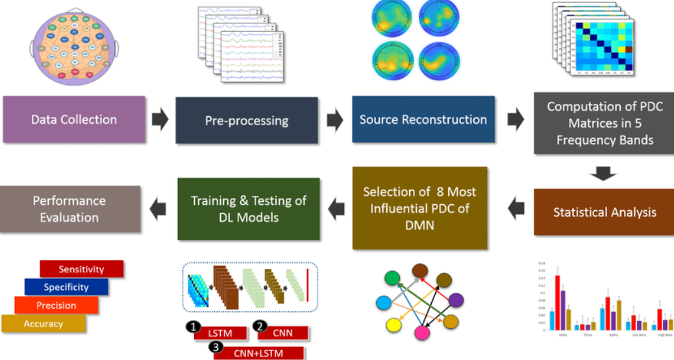
BLOCK DIAGRAM

Slide 7
PROPOSED METHODOLOGY
Collect ECG and EEG signals from sensors or reliable datasets.
Clean the signals to remove noise and artifacts, ensuring high-quality data.
Transform signals to the frequency domain using FFT to uncover hidden patterns.
Extract key spectral features that capture vital cardiac and neurological information.
Feed these features into machine learning models (SVM, Random Forest) for accurate classification.
Visualize both raw and processed signals through an intuitive interface.
Provide real-time predictions for early detection of cardiac or neurological abnormalities.
Enable applications in wearable devices, remote healthcare, and proactive patient monitoring.

Slide 8
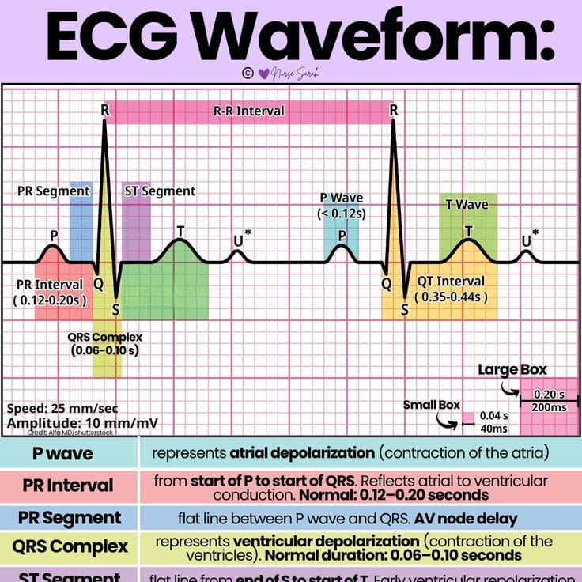

Slide 9
EXPECTED RESULTS/OUTCOMES
Classify signals accurately into normal and abnormal patterns.
Provide real-time visualizations and predictions for early detection.
Extract meaningful features from ECG and EEG signals.

Slide 10
CONCLUSION
The project demonstrates a robust approach to analyzing ECG and EEG signals using Machine learning.
Expected to enable accurate detection of cardiac and neurological abnormalities.
Has potential for real-time monitoring, wearable devices, and remote healthcare applications.
Lays the foundation for a non-invasive, automated diagnostic tool in the future.

Slide 11
REFERNCES
Clifford, G. D., Azuaje, F., & McSharry, P. (2006). Advanced Methods and Tools for ECG Data Analysis. Artech House.
Niedermeyer, E., & da Silva, F. L. (2005). Electroencephalography: Basic Principles, Clinical Applications, and Related Fields. Lippincott Williams & Wilkins.
Acharya, U. R., et al. (2017). Automated detection of arrhythmias using ECG signals. Computers in Biology and Medicine, 89, 389–396.
Python Libraries: NumPy, SciPy, Scikit-learn, Matplotlib.
MATLAB Signal Processing Toolbox Documentation.

Slide 12
Thank you

